Slide 1


Today’s Contents
Histogram processing
Image Histogram
Normalized Histogram
Histogram Stretching
Histogram Equalization
Histogram Specification / Matching
Chapter 3 from R.C. Gonzalez and R.E. Woods, Digital Image Processing (3rd Edition), Prentice Hall, 2008 [ Section 3.3 ] [Exercise Problems 3.1, 3.4, 3.5, 3.6, 3.7]

Slide 2
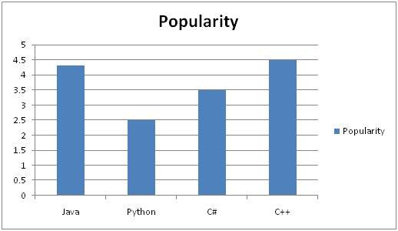

Slide 3

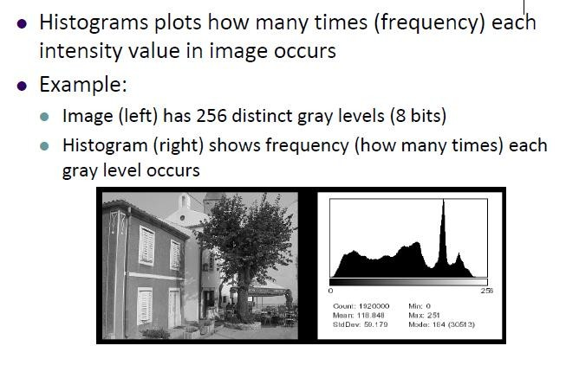
Image Histogram

Slide 4
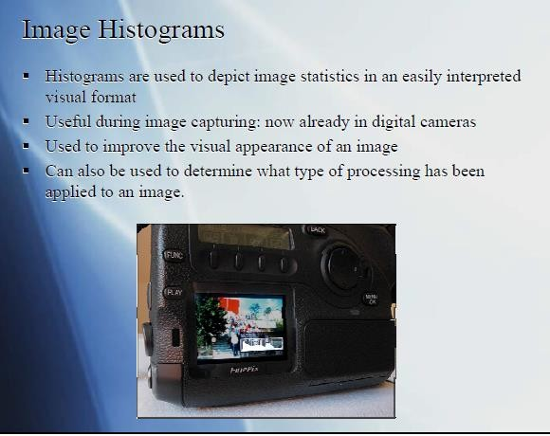
DIP, Spring 2012 GS & AS, Bahria University, Islambad 4

Slide 5

Histogram of a Grayscale Image
⬥ Histogram of a digital image with gray levels in the range [0,L-1] is a discrete function
h(r_{k} ) = n_{k}
Where
r_{k} = k^{th} gray level
n_{k} = number of pixels in the image having gray level r_{k}
h(r_{k}) = histogram of an image having r_{k} gray levels
5

Slide 6
Image Histogram
Assuming image has L gray levels,
a histogram
is an array, h:
bin(0) | bin(1) | . .…. | bin(L-2) | bin(L-1)
h(0)
h(1) . . .
h(L-2)
h(L-1)
bin(i) or h(i) contains the number of pixels with gray level i
h(r_{k} ) = n_{k}

Slide 7






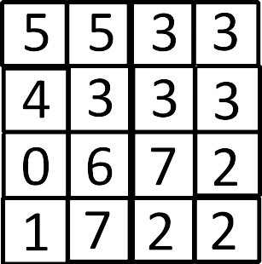
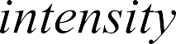
Introduction to Histogram
Bin pos:
0 1 2 3 4 5 6 7
h:
Intensity level L = 2³ = 8
An image

Slide 8







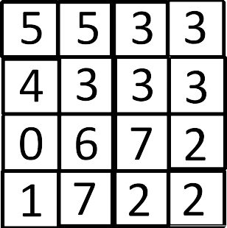
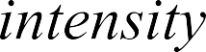

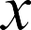
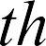
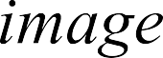
Introduction to Histogram
Bin pos:
0 1 2 3 4 5 6 7
h:
1 | 1 | 3 | 5 | 1 | 2 | 1 | 2

Slide 9
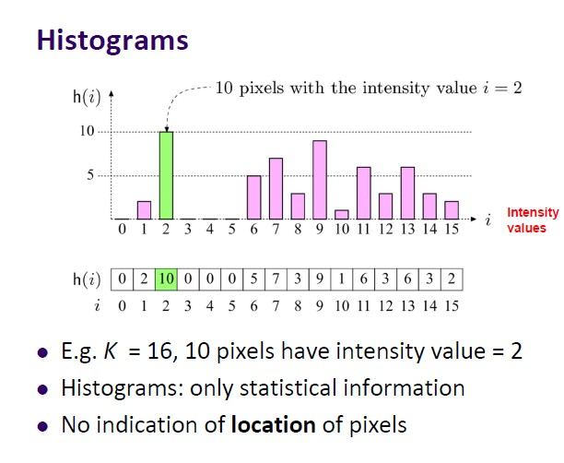

Slide 10
Consider sample.bmp is a 4x4 image with 8-bit gray values.
20 | 210 | 150 | 60
60 | 150 | 60 | 150
150 | 60 | 210 | 150
150 | 20 | 150 | 20
Sample.bmp
Calculate the histogram of Sample.bmp and sketch it.

Slide 11
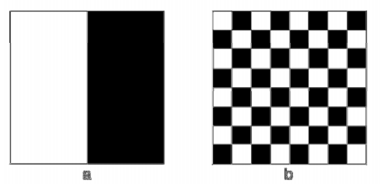
Suppose that both images have size 20×20, black (0) and white (1) pixels.
with
Their histograms are identical???

Slide 12
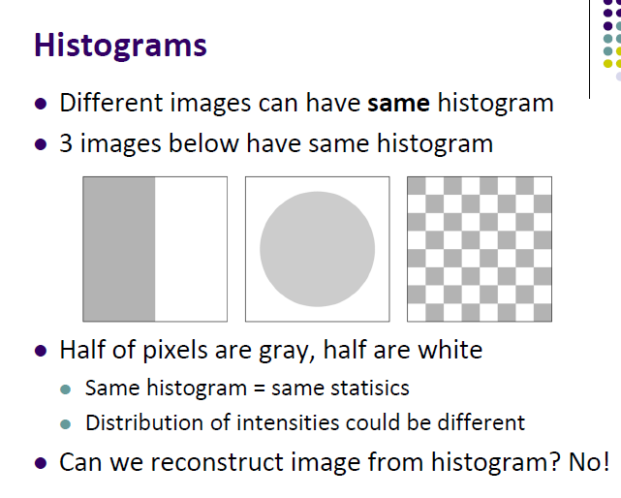

Slide 13
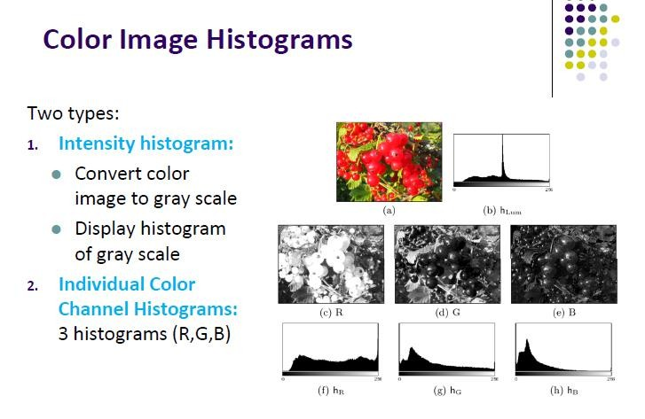

Slide 14
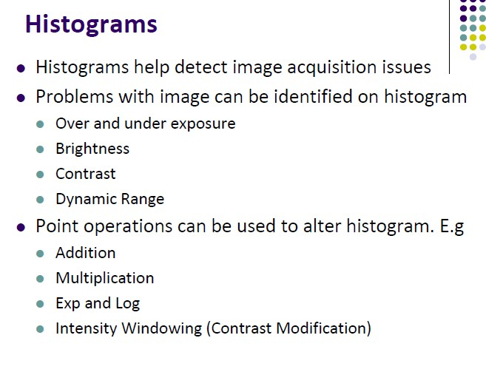

Slide 15
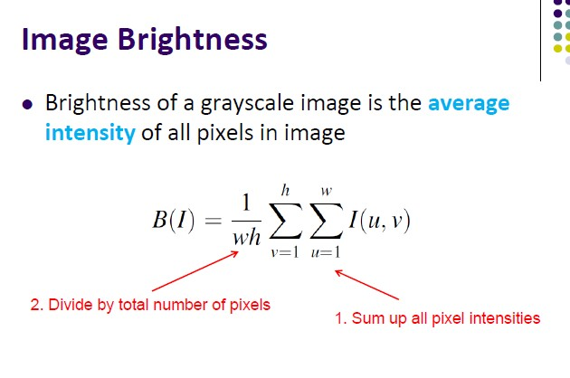

Slide 16
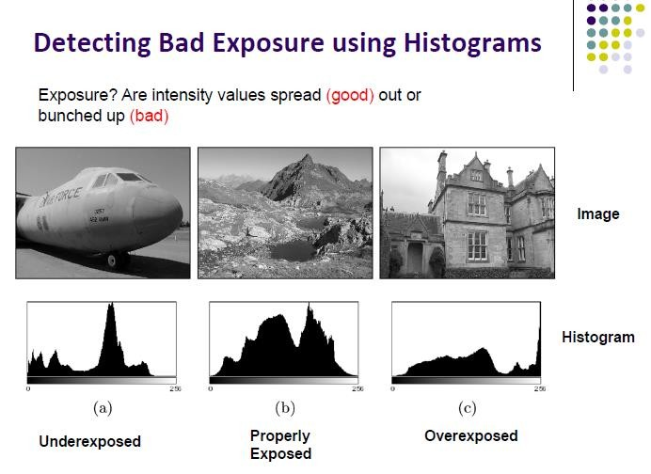

Slide 17
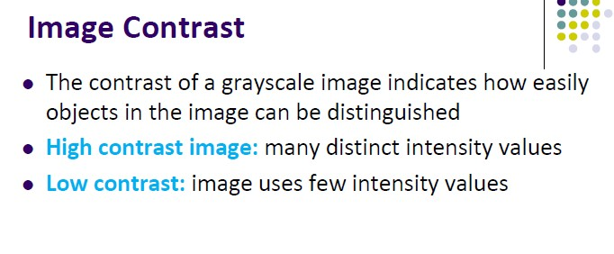

Slide 18
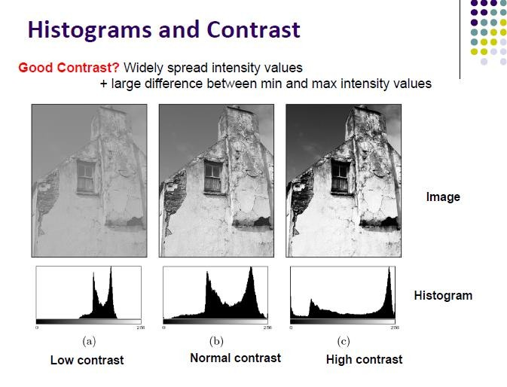

Slide 19

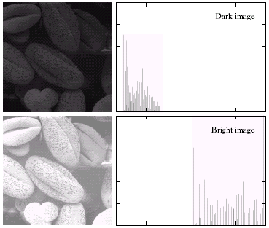
Histogram: Example
How would the histograms of these images look like?
Dark Image
Bright Image
19

Slide 20
Histogram: Example
Dark image Components of histogram are concentrated on the low side of the gray scale
Bright image Components of histogram are concentrated on the high side of the gray scale
20

Slide 21
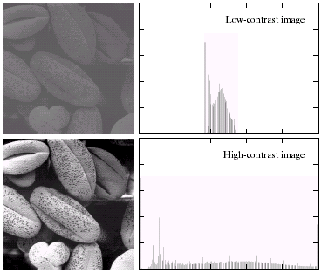
Histogram: Example
How would the histograms of these images look like?
Low Contrast Image
High Contrast Image
21

Slide 22
Histogram: Example
Low contrast image Histogram is narrow and centered toward the middle of the gray scale
High contrast image Histogram covers broad range of the gray scale and the distribution of pixels is not too far from uniform with very few vertical lines being much higher than the others
22

Slide 23
Normalized Histogram
⬥ Dividing each of histogram at gray level r_{k} by the total number of pixels in the image, n
p(r_{k} ) = n_{k} / n
⬥ p(r_{k}) gives an estimation of the probability of occurrence of gray level r_{k}
⬥ The sum of all components of a normalized histogram is equal to 1
23

Slide 24
p(r_{k} ) = n_{k} / n
Normalized Image Histogram(Cont.)
where, n = ∑ n_{k}
k
Normalized histogram is more like probabilities
p(r_{k}): how likely a pixel will have gray level r_{k}

Slide 25
Normalized Image Histogram(Cont.)
9 | 8 | 9 | 8
2 | 7 | 4 | 7
6 | 4 | 6 | 1
4 | 0 | 7 | 4
An image (cropped)
Bin pos: 0 1
h:
p(r_{k}):
Histogram:
2 3 4 5 6 7 8 9
1 | 1 | 1 | 0 | 4 | 0 | 2 | 3 | 2 | 2
1/16 | 1/16 | 1/16 | 0 | 1/4 | 0 | 1/8 | 3/16 | 1/8 | 1/8
DIP, Spring 2012 GS & AS, Bahria University, Islambad

Slide 26
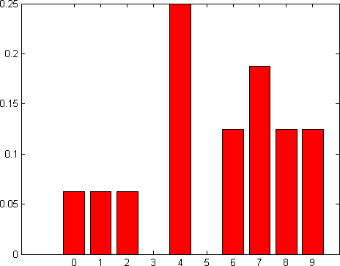
Normalized Image Histogram(Cont.)
0 1 2 3 4 5 6 7 8 9

Slide 27
The Probability Distribution Function of an Image
p(g) is the fraction of pixels in an image that have intensity value g.
p(g) is the probability that a pixel randomly selected from the given image has intensity value g.
Whereas the sum of the histogram h(g) over all g from 0 to 255 is equal to the number of pixels in the image, the sum of p(g) over all g is 1.
p is the normalized histogram of the image
27

Slide 28
Review: Consider sample.bmp is a 4x4 image with 8-bit gray values.
20 | 210 | 150 | 60
60 | 150 | 60 | 150
150 | 60 | 210 | 150
150 | 20 | 150 | 20
Sample.bmp
Calculate the normalized histogram (PDF) of Sample.bmp.
DIP, Spring 2012 GS & AS, Bahria University, Islambad

Slide 29
HISTOGRAM PROCESSING TECHNIQUES
The transformation function (processing technique) T is applied to an input image f(x, y) which gives the processed output image g(x, y).
g(x, y) =T (f(x, y))
Histogram Sliding
Histogram Stretching
Histogram Equalization

Slide 30
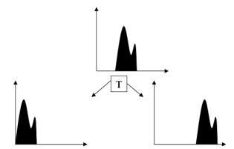
Histogram Sliding
the complete histogram is simply shifted towards rightwards or leftwards.
a clear change will seen in the brightness of image.

Slide 31
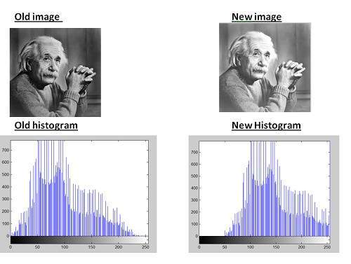

Slide 32

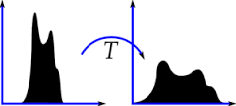
Histogram Stretching
Histogram Stretching is process of increasing the contrast of an image.
Contrast is defined as the difference between maximum and minimum pixel intensity values in an image.

Slide 33
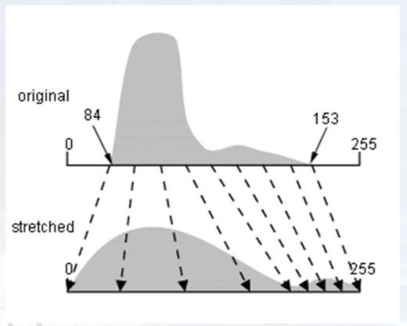
Contrast Stretching
Improve the contrast in an image by `stretching' the range of intensity values it contains to span a desired range of values, e.g. the full range of pixel values
33

Slide 34

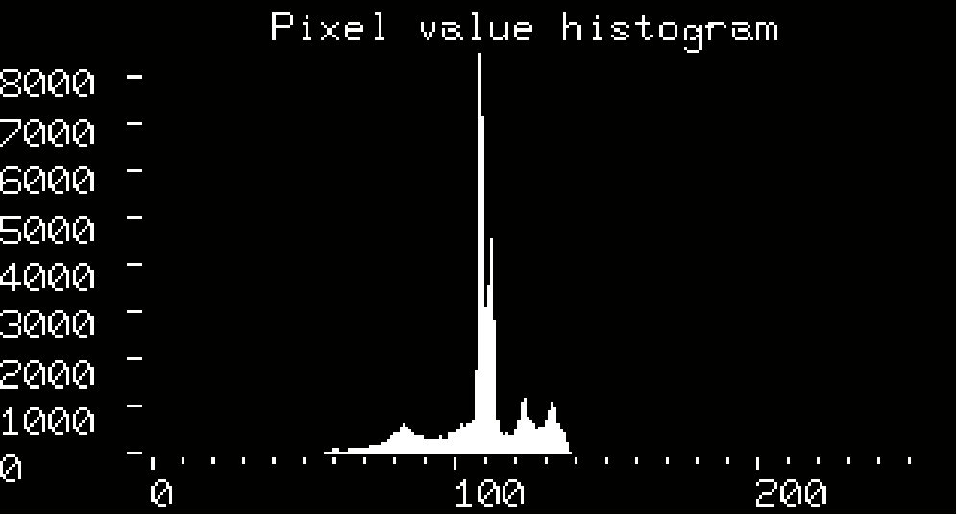

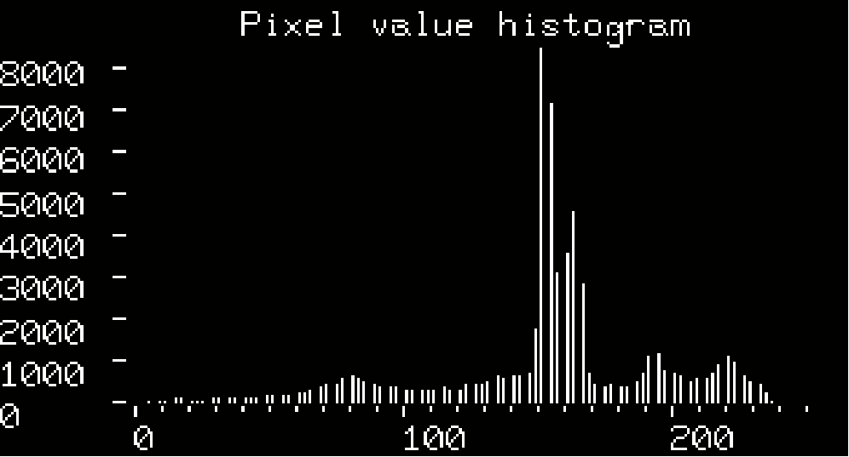
Contrast Stretching
34

Slide 35
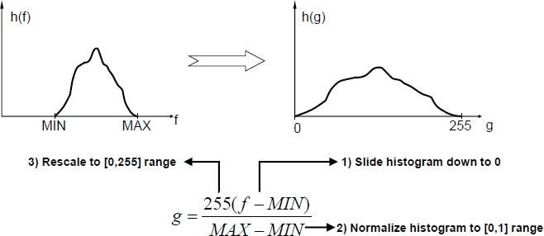
Histogram Stretching

Slide 36
Example
If MIN = 5 and MAX = 205 g = {255/(205-5)} x (f - 5)
= 1.275 x (f-5)
f | g | g | H(g)
5 | 1.275 x (5-5) = 0 | 0 | h (5) => H(0)?
6 | 1.275 x (6-5) = 1.275 | 1 | ?
7 | 1.275 x (7-5) = 2.55 | 3 | ?
8 | 1.275 x (8-5) = 3.825 | 4 | ?
9 | 1.275 x (9-5) = 5.1 | 5 | ?
.. | ….. | .. | ..
.. | ….. | .. | ..
205 | 1.275 x (205-5) = 255 | 255 | ?

Slide 37
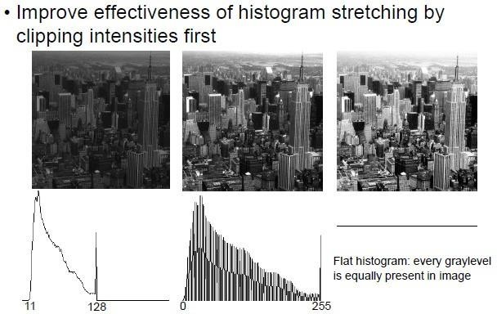
Example 2

Slide 38
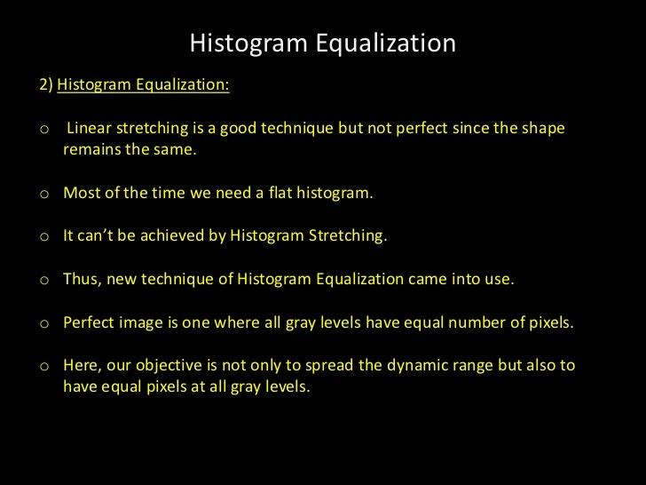
Histogram Equalization

Slide 39
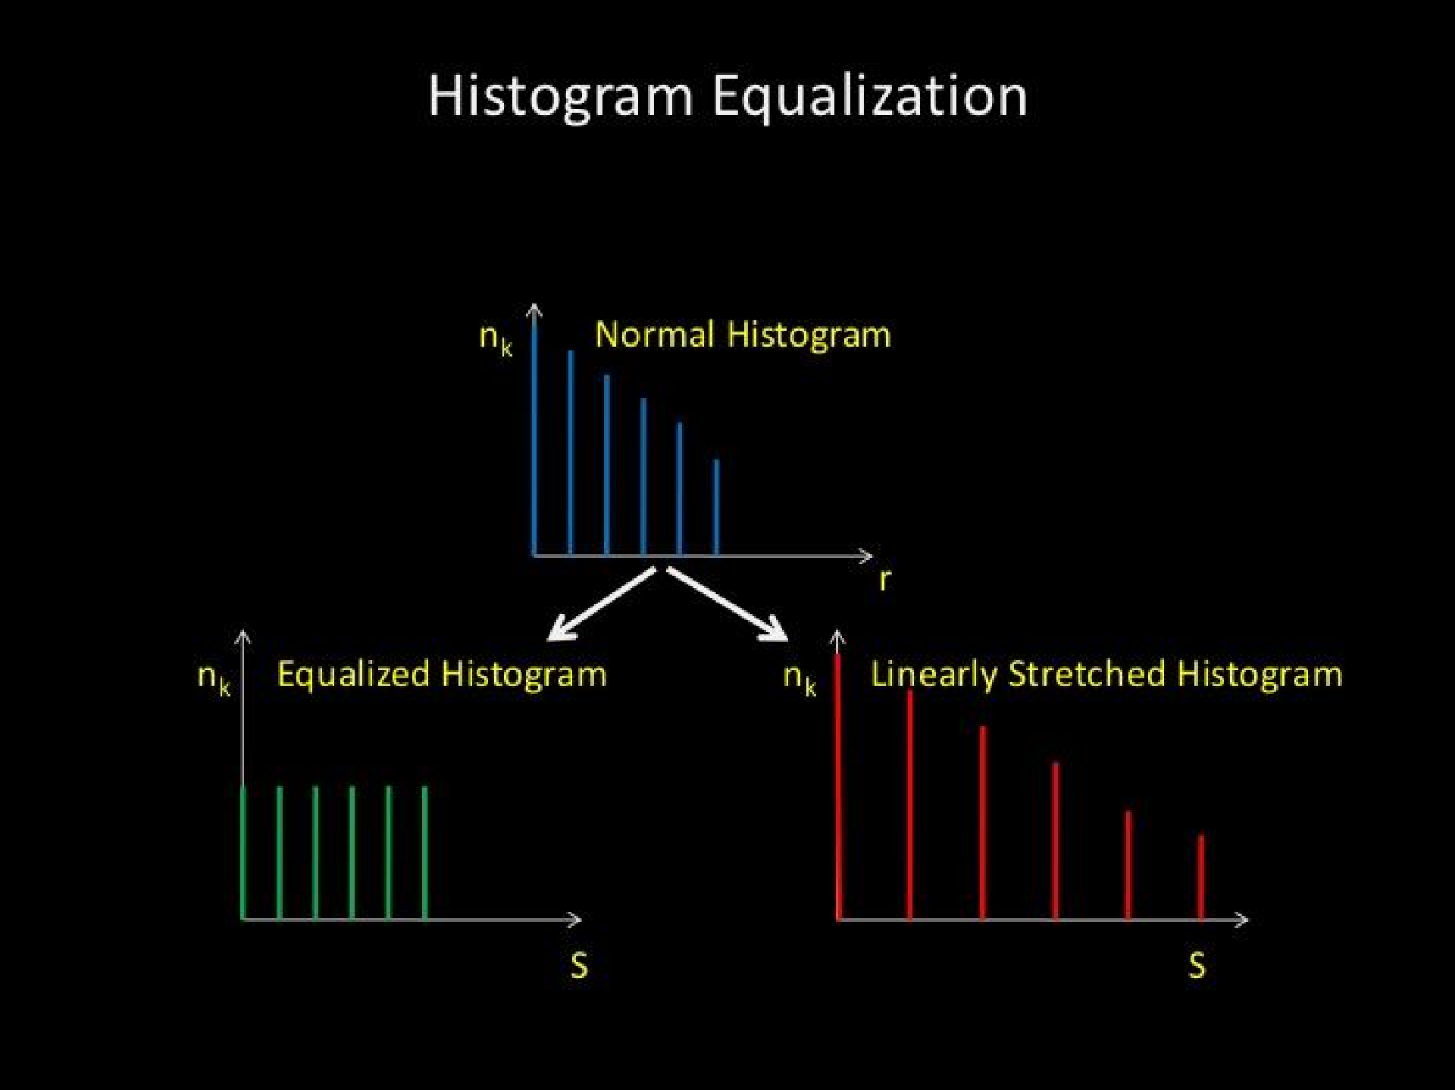
Histogram Equalization
1/22/2019 38

Slide 40
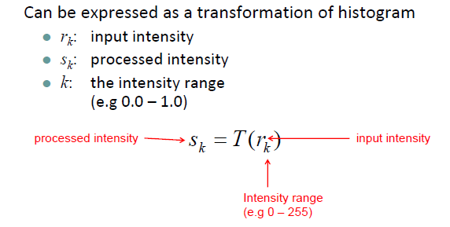
Histogram Equalization

Slide 41
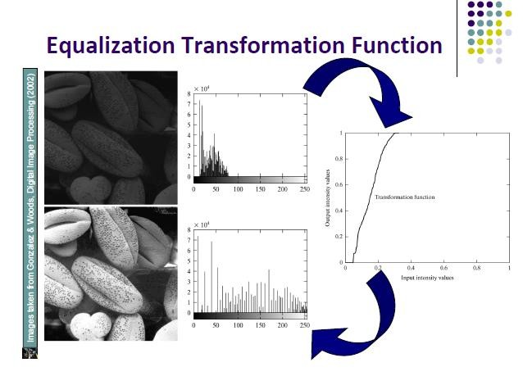

Slide 42
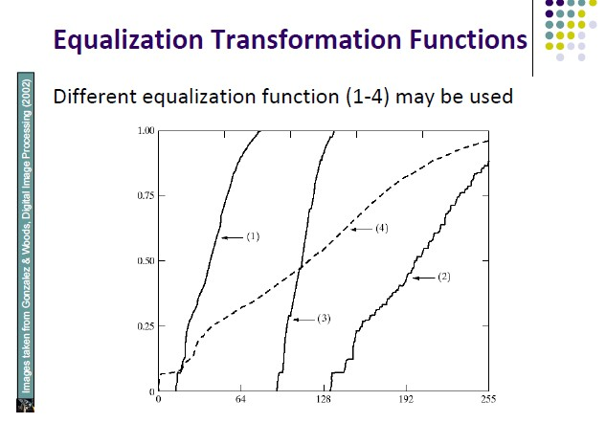
for different images.
Output intensity values -------→
Dark Image
Bright Image
Low contrast
High contrast
Input intensity values -------→

Slide 43
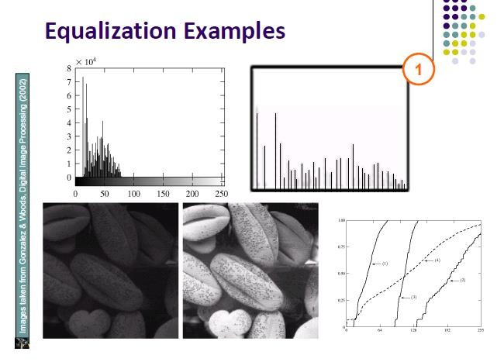

Slide 44
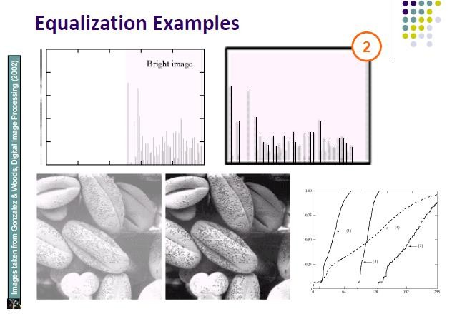

Slide 45
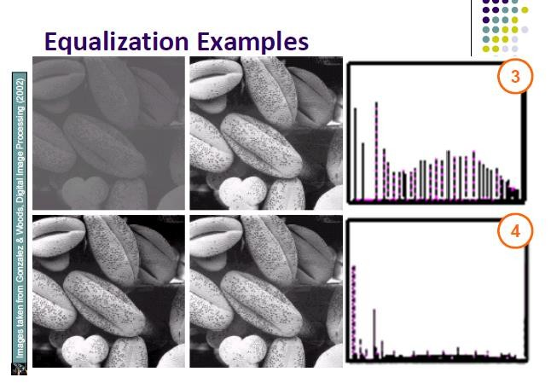

Slide 46
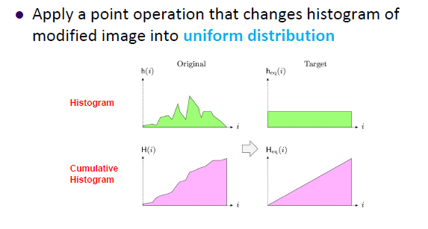
Histogram Equalization

Slide 47
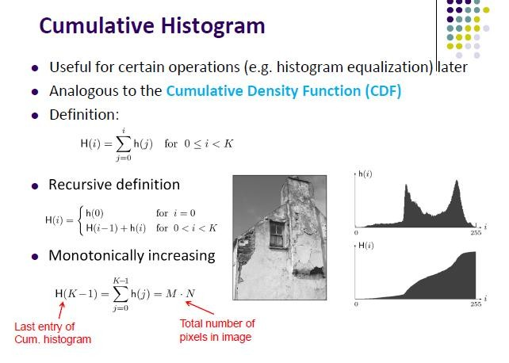

Slide 48
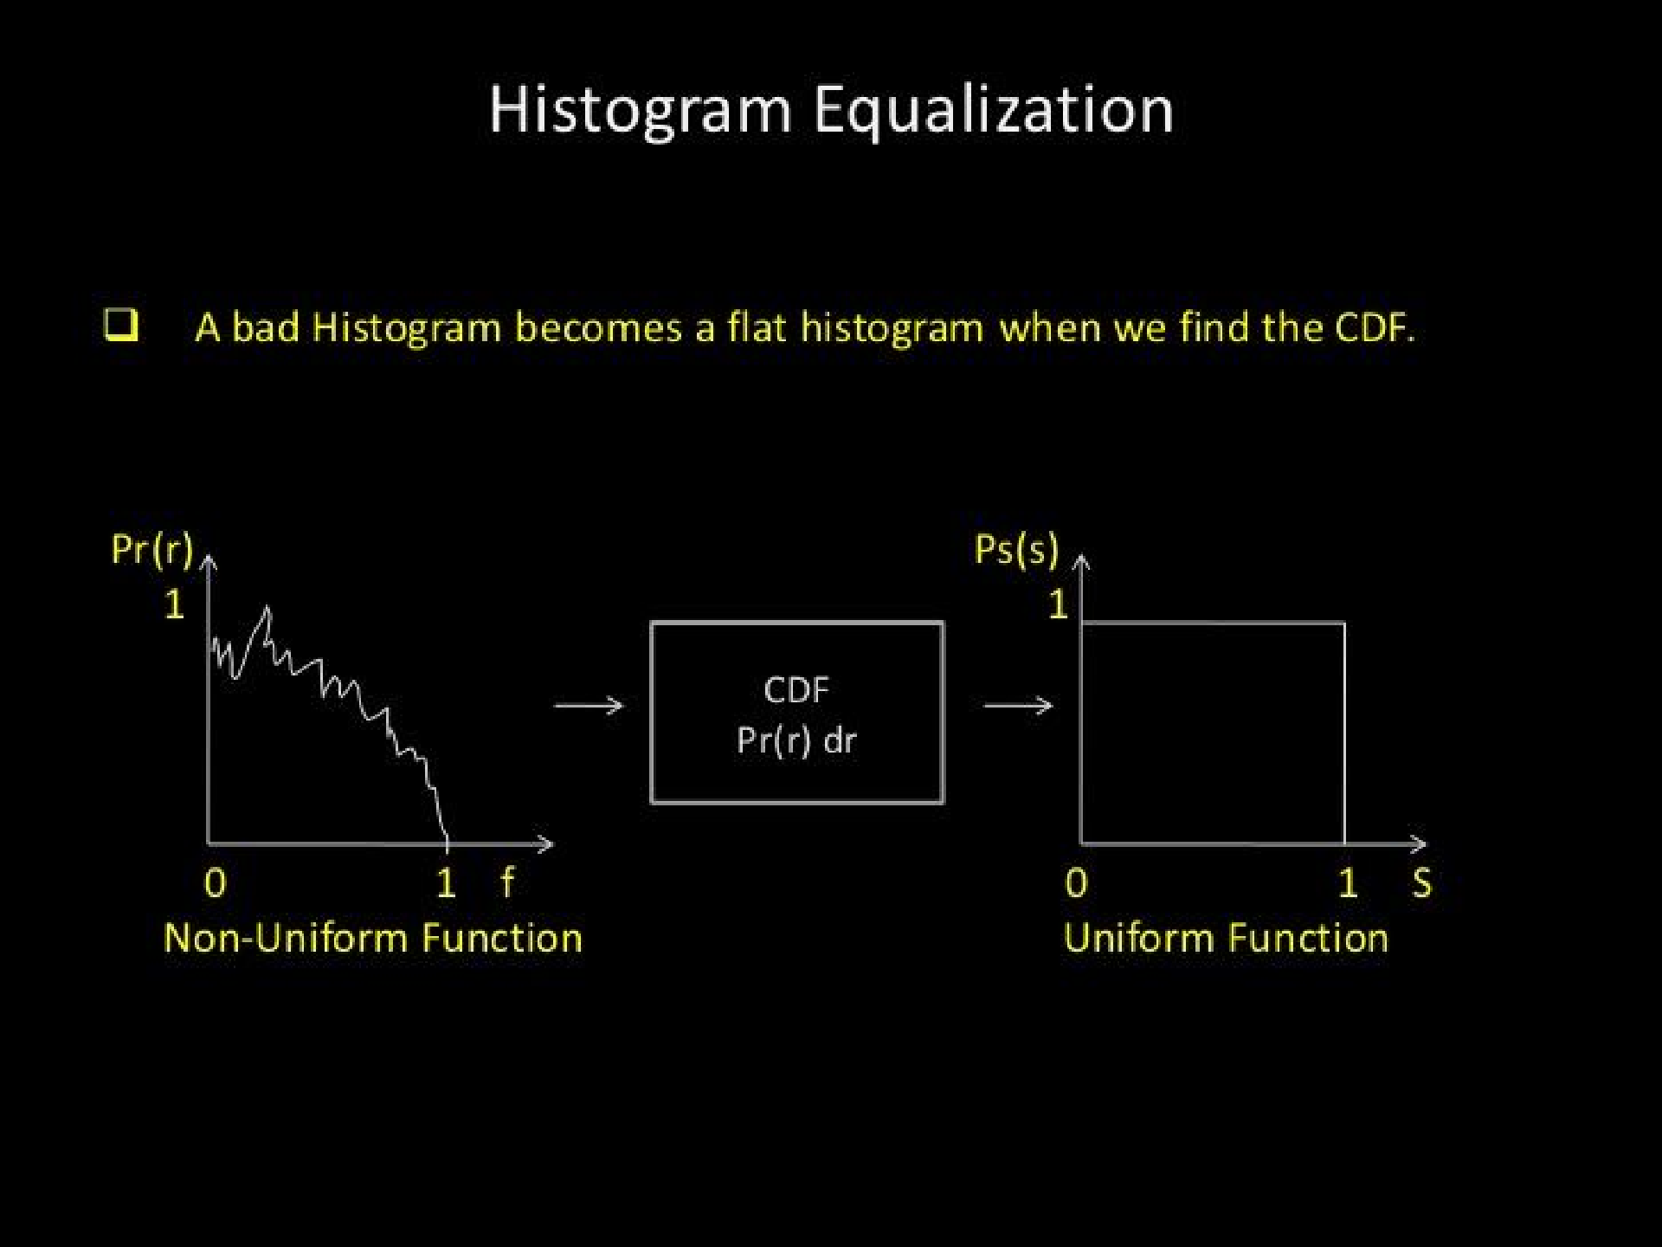
1/22/2019
47

Slide 49
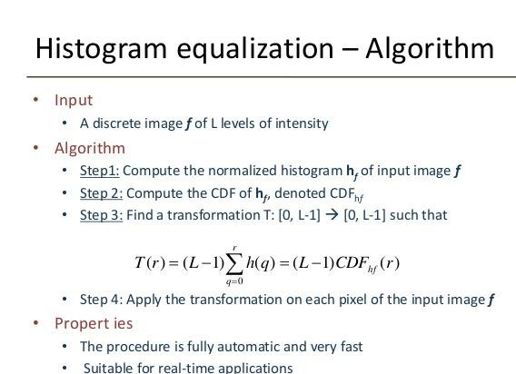
DIP, Spring 2012 GS & AS, Bahria University, Islambad 48

Slide 50
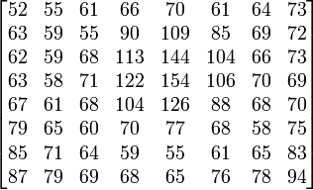

Histogram Equalization: Example
An 8x8 image
i.e. total number of pixels is 64.

Slide 51



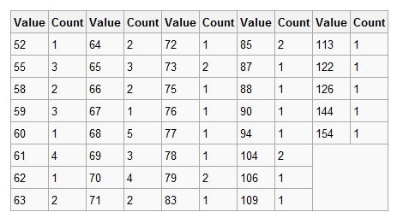
Histogram Equalization: Example
Fill in the following table/histogram
Image Histogram (Non-zero values)

Slide 52
Histogram Equalization: Example
Image Histogram (Non-zero values shown)

Slide 53
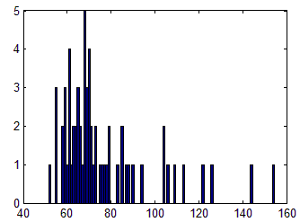
Histogram Equalization: Example
Image Histogram

Slide 54
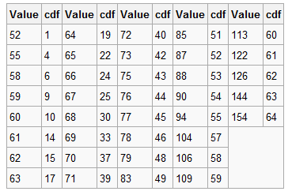
Histogram Equalization: Example
Cumulative Distribution Function (CDF)

Slide 55


Histogram Equalization: Example
Cumulative Distribution Function (CDF)
CDF is NOT normalized

Slide 56
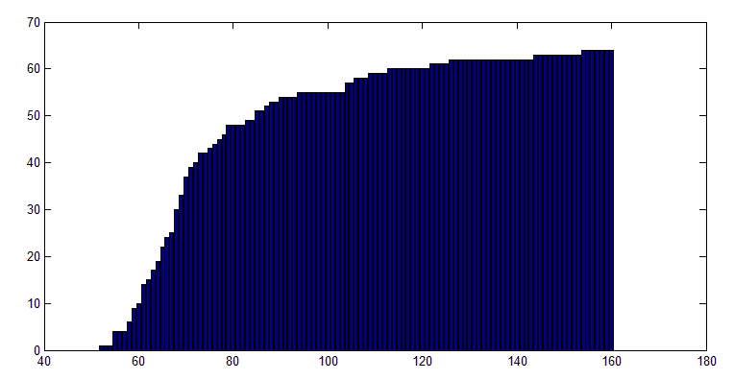
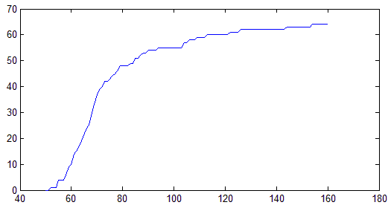
Histogram Equalization: Example
Cumulative Distribution Function (CDF)
CDF
Intensity of input image, r

Slide 57
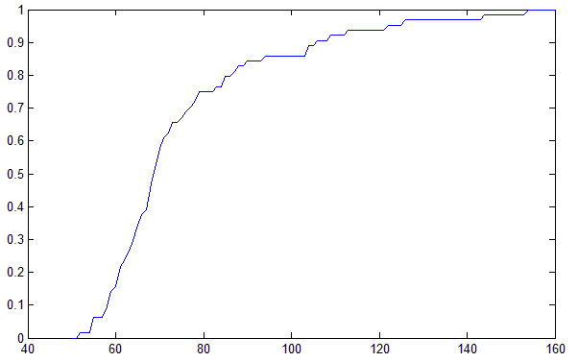


Histogram Equalization: Example
Normalized Cumulative Distribution Function (CDF)
Normalized CDF
Divide each value by total number of pixels (64) to get the normalized CDF
Intensity of input image, r

Slide 58





Histogram Equalization: Example
If CDF is normalized
s = round(255.cdf (r))
s = round (255. ^{cdf (r)})
M × N
s = round (255.(46 / 64))
s = 183
If CDF is NOT normalized
4 | 16 | 56 | 96 | 147
 |  |  |  |  |  | 183
Original Image

Slide 59

Before and After Histogram Equalization:

Slide 60
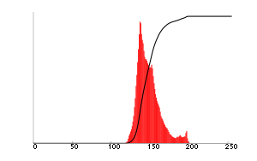



Histogram Equalization: Example
Original Image
Corresponding histogram (red) and
cumulative histogram (black)
Image after histogram equalization
Corresponding histogram (red) and cumulative
histogram (black)
59

Slide 61

1/22/2019
60

Slide 62

850
1/22/2019 61

Slide 63

After
1/22/2019 62

Slide 64

Class Work
1/22/2019 63

Slide 65

Class Work: Answer
1/22/2019 64

Slide 66



Histogram Equalization vs.
Contrast Stretching
Histogram equalization is sophisticated version of contrast stretching
Original Image
Contrast Stretching
Histogram Equalization
Dramatic Enhancement - Artificial look
Contrast Stretching – Enhancement is less harsh

Slide 67

1/22/2019
66

Slide 68


More Example of Histogram Equalization
Suppose that a 3-bit image (L=8) of size 64 × 64 pixels (MN = 4096)
has the intensity distribution shown in following table.
Get the histogram equalization transformation function and give the p_{s}(s_{k}) for each s_{k}.

Slide 69

Example: Histogram Equalization
s₀ = T (r₀ ) = 7∑ p_{r} (r_{j} ) = 7 × 0.19 = 1.33
j =0
s₁ = T (r₁ ) = 7∑ p_{r} (r_{j} ) = 7 ×(0.19 + 0.25) = 3.08
0
→1
→ 3
1
j =0
s₂ = 4.55 → 5
s₄ = 6.23 → 6
s₆ = 6.86 → 7
s₃ = 5.67 → 6
s₅ = 6.65 → 7
s₇ = 7.00 → 7

Slide 70

Example: Histogram Equalization

Slide 71
Note
Histogram equalization has a disadvantage:
It can generate only one type of output image.
With histogram specification we can specify the shape of the histogram that we wish the output image to have.
It doesn’t have to be a uniform histogram.
Histogram specification is a trial-and-error process.
There are no rules for specifying histograms, and one must resort to analysis on a case-by-case basis for any given enhancement task.

Slide 72

1/22/2019
72

Slide 73

1/22/2019
73

Slide 74
Histogram Specification
Here we want to convert the image so that it has a particular histogram that can be arbitrarily specified. Such a mapping function can be found in three steps:
Equalize the histogram of the input image
Equalize the specified histogram
Relate the two equalized histograms

Slide 75

1/22/2019
74

Slide 76


CDF calculation for input histogram
0
s₀ = T (r₀ ) = 7∑ p_{r} (r_{j} ) = 7 × 0.19 = 1.33
1
j =0
s₁ = T (r₁ ) = 7∑ p_{r} (r_{j} ) = 7 ×(0.19 + 0.25) = 3.08
j =0
1
3
s₂ = 4.55 → 5
s₄ = 6.23 → 6
s₆ = 6.86 → 7
s₃ = 5.67 → 6
s₅ = 6.65 → 7
s₇ = 7.00 → 7
6

Slide 77


CDF calculation for specified histogram

Slide 78



CDF calculation for specified histogram

Slide 79

Example: Histogram Matching
zq
0.0
0.0
0.0
0.15
0.20
0.30
0.20
0.15
Overall mapping
r | P(rk) | cdf(rk) | cdf(zp) | zq | P(s)
0 | 0.19 | 0.19 | 0.0 | 3 | 0.19
1 | 0.25 | 0.44 | 0.0 | 4 | 0.25
2 | 0.21 | 0.65 | 0.0 | 5 | 0.21
3 | 0.16 | 0.81 | 0.15 | 6 | 0.24
4 | 0.08 | 0.89 | 0.35 | 6 | 0.24
5 | 0.06 | 0.95 | 0.65 | 7 | 0.11
6 | 0.03 | 0.98 | 0.85 | 7 | 0.11
7 | 0.02 | 1.0 | 1.0 | 7 | 0.11
Here is the look-up table:
i | 0 | 1 | 2 | 3 | 4 | 5 | 6 | 7
j | 3 | 4 | 5 | 6 | 6 | 7 | 7 | 7

Slide 80

zq | P(s)
3 | 0.19
4 | 0.25
5 | 0.21
6 | 0.24
7 | 0.11
1/22/2019 79

Slide 81
Consider “cat.tif” is a 64X64 image with 4 bit gray values.
The histogram “cat.tif” is given below:
Gray Values | No. of Pixels
2 | 90
4 | 123
5 | 1550
8 | 965
9 | 245
10 | 122
12 | 101
Sketch the normalize histogram of “cat.tif ”.
Make a equalize histogram of “cat.tif”.
Sketch the equalize histogram transformation function of cat.tif”.

Slide 82





HOME WORK
Suppose that a digital image is subjected to histogram equalization . Show that a second pass of histogram equalization will produce exactly the same result as the first pass.

Slide 83

1/22/2019
83

Slide 84

1/22/2019
84

Slide 85

1/22/2019
85

Slide 86

1/22/2019
86

Slide 87

1/22/2019
87

Slide 88

1/22/2019
88

